Slide 1



Introduction to Computer and Programming Language
Topic 1

Slide 2

Objectives
To learn about the hardware and software components of computers
To learn about level of programming languages
To learn about the roles of compilers & interpreters in the translation process
To understand the activity of programming
To compile and run your first Java program
To recognize 3 types of errors

Slide 3

What is a computer?
An electronic device that stores and processes data
Consists of hardware and software.
Hardware
the physical, tangible parts of a computer.
keyboard, monitor, disks, wires, etc.
Software
programs (e.g. Ms Word) and data.
Intangible parts of the computer.
Both hardware and software form a tool that can be used to solve problems.

Slide 4
Computer System Organization
Computer System Organization
Hardware
Central Processing Unit (CPU)
Main Memory: Random
Access Memory (RAM)
Secondary Storage
Input / Output Devices
Software
System Software
Application Software
c
B

Slide 5
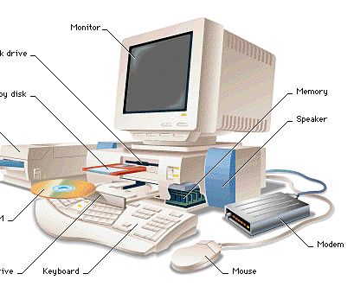
Hardware Components of a Computer

Slide 6
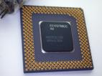
Hardware Components of a Computer
CPU
Brain of the computer,
Handles all instructions that we give to the computer.
Most expensive, the more expensive, the faster is the computer.
CPU components:
Control Unit
Program Counter
Registers
Arithmetic Logic Unit
Accumulator

Slide 7
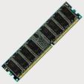
Hardware Components of a Computer
RAM
Temporary memory.
Volatile (information stored in it will be lost when electric power supply is turned off).
Directly connected to the CPU, using memory cells unit.

Slide 8
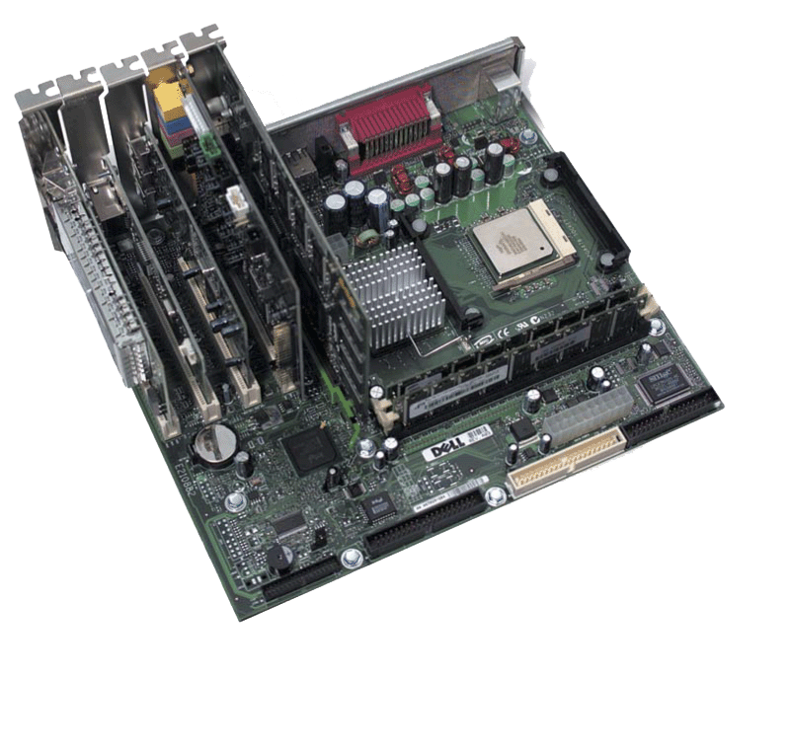
Hardware Components of a Computer
Motherboard
adapter cards
processor chip
memory chips
memory slots
Expansion slots for adapter cards

Slide 9
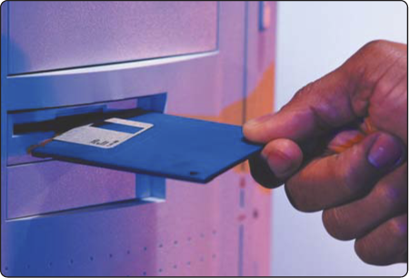
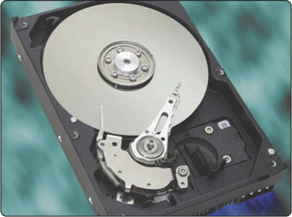
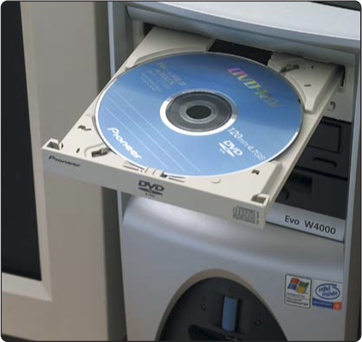
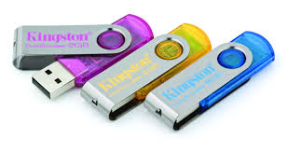
Hardware Components of a Computer
Secondary Storage
Provides permanent storage for information.
Examples of secondary storage:
Hard disks
Floppy disks
CD-ROMs
USB Flash Drives

Slide 10
RAM VS. Secondary Storage
RAM / Main Memory / Primary Memory
Volatile
Fast
Expensive
Low capacity
Works directly with the processor
Secondary Storage / Secondary Memory
Nonvolatile
Slow
Cheap
Large capacity
Not connected directly to the processor

Slide 11
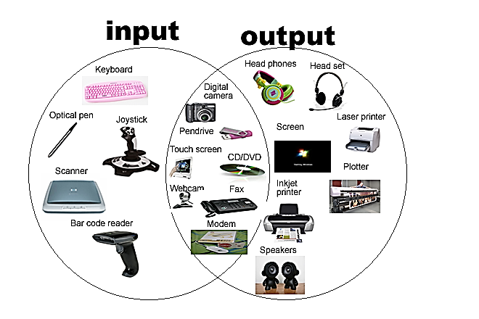
Hardware Components of a Computer
Input and output
Allow human to interact with the computer

Slide 12
CPU and Main Memory
Chip that executes program commands
E.g.
Intel Core i-7-4960X
CPU
Interact to execute instructions
Primary storage area for programs and data that are in active use
(RAM)
Main
Memory

Slide 13
Secondary Memory Devices
CPU
Secondary memory
devices provide
long-term storage
Hard Disk
Main
Memory
Information is moved
between main memory
and secondary memory
as needed
USB Flash Drive
Hard disks, Floppy disks, USB drives, Writable CDs, Writable DVDs

Slide 14
Input / Output Devices
Monitor
I/O devices facilitate
user interaction
CPU
Mouse
Monitor screen
Keyboard
Joystick
Bar code scanner
Touch screen
Hard Disk
Main
Memory
USB Flash Drive

Slide 15

Think
Imagine that you are using a computer to write a letter.
Where is the Microsoft Word program that you are running located?
Where are the characters you have typed placed?

Slide 16
Software
In contrast to hardware, software is an abstract, intangible entity.
Software can be categorized as system or application software (refer next slide).
It consists of program and data to be used to perform certain tasks.
A program is a sequence of simple steps and operations, stated in a precise language that the hardware can interpret.
The process of programming involve algorithm design & coding.

Slide 17
Software Categories
System Software
System programs keep all the hardware and software running together smoothly.
The most important system software is the operating system (OS).
Controls all machine activities.
Provides the user interface to the computer.
Manages resources such as the CPU, memory & I/O.
E.g: Windows 10, Unix, Linux, Mac OS.
Application Software
Generic term for any other kind of software
E.g: Ms Word processor, Excel Spreadsheets, Web browsers, games

Slide 18
Digital Information
Computers store all information digitally:
numbers
text
graphics and images
video
audio
program instructions
In some way, all information is digitized - broken down into pieces and represented as numbers

Slide 19
Representing Text Digitally
For example, every character is stored as a number, including spaces, digits, and punctuation.
Corresponding upper and lower case letters are considered as different characters.
H i , H e a t h e r .
72 105 44 32 72 101 97 116 104 101 114 46

Slide 20
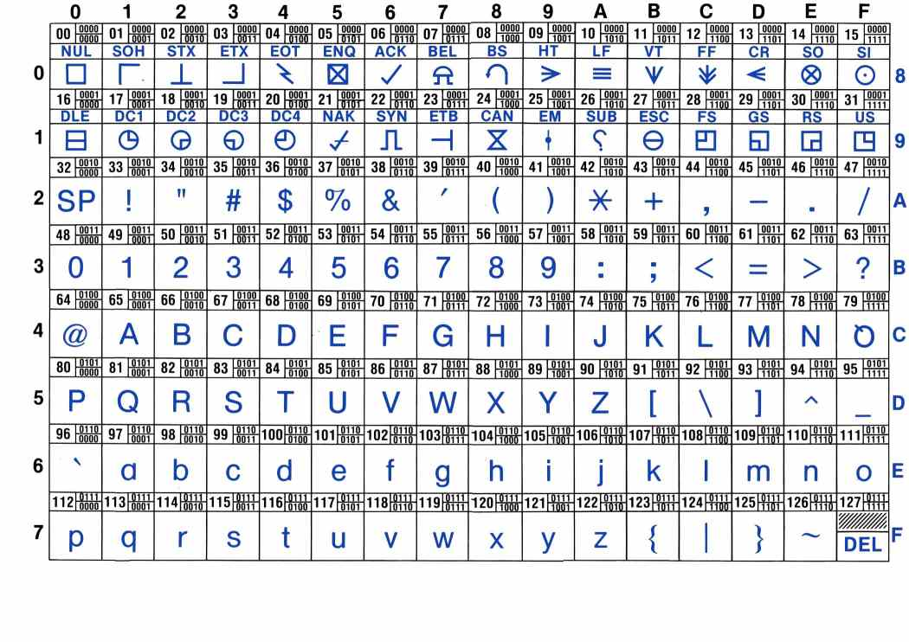
American Standard Code for Computer InterChange (ASCII)
The ASCII data set → 128 characters (0 until 127)
Character A in ASCII → 01000001
p. 4.15 Fig. 4-16
Next

Slide 21
Binary Numbers
Once information is digitized, it is represented and stored in memory using the binary number system.
A single binary digit (0 or 1) is called a bit.
A byte consists of 8 bits.
Each byte in main memory resides at a numbered location called its address.

Slide 22
Main Memory
Addresses
9278
9279
9280
9281
9282
9283
9284
9285
9286
Main memory is divided into many memory locations (or cells)
Each memory cell has a numeric address, which uniquely identifies it

Slide 23
Storing Information
Each memory cell stores a set number of bits (usually 8 bits, or one byte)
9278
9279
9280
9281
9282
9283
9284
9285
9286
01001010
Represents ‘J’
01100001
Represents ‘a’
01110110
Represents ‘v’
01100001
Represents ‘a’
Large values are
stored in consecutive
memory locations

Slide 24
Main Memory

Slide 25
Storage Capacity
Every memory device has a storage capacity, indicating the number of bytes it can hold.
Capacities are expressed in various units:
Unit Symbol Number of Bytes
kilobyte
megabyte
gigabyte
terabyte
KB 2¹⁰ = 1024
MB 2²⁰ (over 1 million)
GB 2³⁰ (over 1 billion)
TB 2⁴⁰ (over 1 trillion)

Slide 26

What is Programming?
Computer programming
the art and science of designing and writing computer programs.
Computer program
a sequence of instructions written in a programming language to achieve a task/to solve a problem.

Slide 27
Language Levels
Levels of programming language levels:
machine language (computer directly understands)
assembly language (symbolic form, need minor translation)
high-level language (entire language need to be translated )
Each type of CPU has its own specific machine language

Slide 28
Programming Languages
Machine language 101101100110 011011010
Assembly language ADDF3 R1,R2,R3
High-level language sum = 3+4;

Slide 29
Programming Languages
Each type of CPU executes instructions only in a particular machine language.
A program must be translated into machine language before it can be executed.
A compiler is a software tool which translates from high level language into a specific machine language.
An assembler translates from assembly language into a specific machine language.

Slide 30
Programming Languages
Languages | Descriptions | Examples | Translators
Machine | Instruction in 0 and 1 bits | 0111000011000001 | None
Assembly | Instruction in mnemonic code | LOAD 3 STOR 4 ADD | Assembler
High-level | Similar to human language, e.g. FORTRAN, COBOL, Pascal, C, C++, Java | sum = 3 + 4; | Compiler & interpreter

Slide 31

The Java Programming Language
Created by Sun Microsystems, Inc.
Introduced in 1995 and it's popularity has grown quickly.
Rich library
Platform-independent("write once, run anywhere") or architecture-neutral

Slide 32
Java Translation
The Java compiler translates Java source code into a special representation called bytecode.
Java bytecode is not the machine language for any traditional CPU.
Another Java software tool, called an interpreter or Java Virtual Machine (JVM), translates bytecode into machine language and executes it.

Slide 33
Java Translation
Java source
code (program)
Java
compiler
Java
bytecode
Bytecode
interpreter
Machine
code
(Code is executed)

Slide 34
Portability
After compiling a Java program into bytecode, that bytecode can be used on any computer with a bytecode interpreter and without a need to recompile.
Bytecode can be sent over the Internet and used anywhere in the world.
This makes Java suitable for Internet applications.

Slide 35
Setting up Your Computer to use Java
Understand files and folders/directories
Install JDK
Java SE Download Page: http://www.oracle.com/technetwork/java/javase/downloads/index.html
Documentation
Tutorial
Install jGRASP
http://www.jgrasp.org/

Slide 36
Setting up Your Computer to use Java
IDE (Integrated Development Environment)
a software application that can facilitate programmers to develop program
Write, save, compile & run program in a single environment
E.g. jGrasp, Netbeans, Eclipse, BlueJay

Slide 37
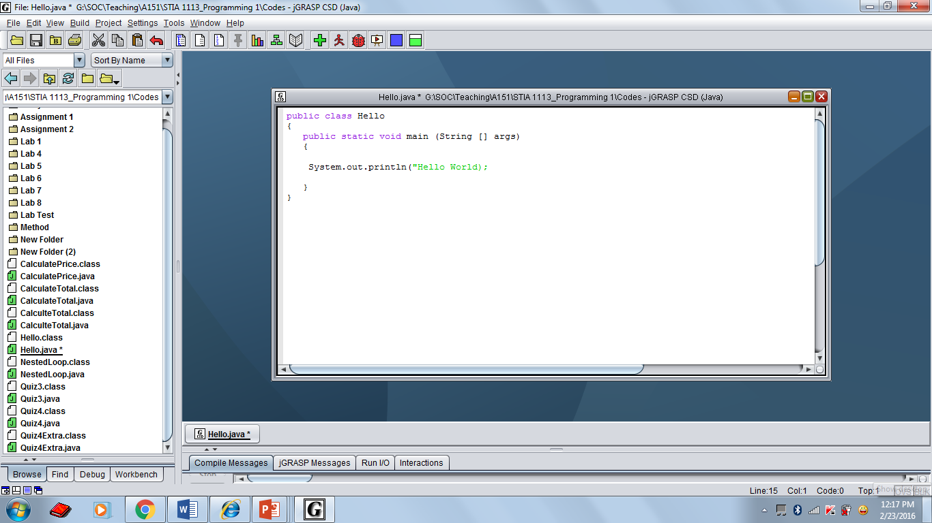
jGRASP IDE

Slide 38
File Hello.java
public class Hello
{
public static void main(String[] args)
{
// display a greeting in the console window
System.out.println("Hello World!");
}
}

Slide 39
Java Program Elements
A Java program is made up of class definitions.
A class definition must contain a header and a body.
A class contains zero or more methods
A method is a named section of code that also has a header & body
A method contains program statements
Comments are used to document the code, will not be interpreted
Single-line (starts with //)
Multi-line (enclosed by /* and */)

Slide 40
Java Program Structure
// comments about the class
public class Hello
{
}
class header
class body
/*Comments can be placed almost
anywhere*/

Slide 41
Java Program Structure
// comments about the class
public class MyProgram
{
}
// comments about the method
public static void main (String[] args)
{
}
Main method body
Main method header

Slide 42
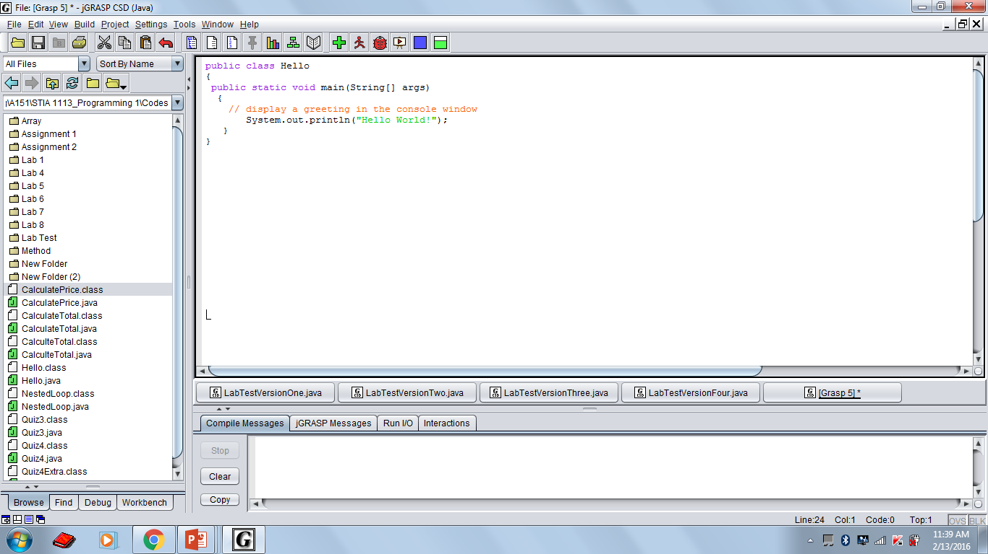
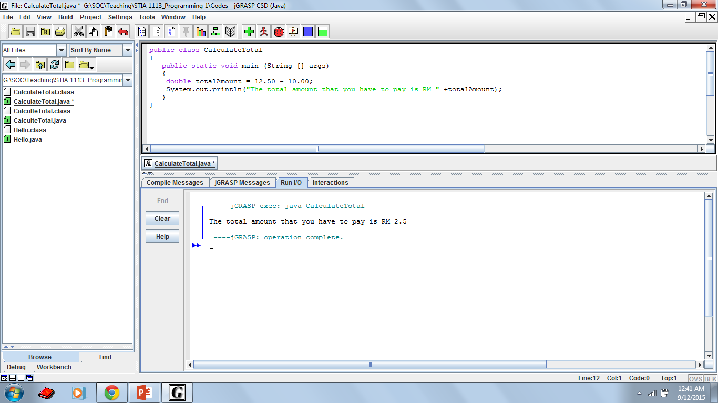
Compiling and Running
Type program into text editor
Save: file name must be similar to class name
Compile into byte codes
Execute byte codes

Slide 43
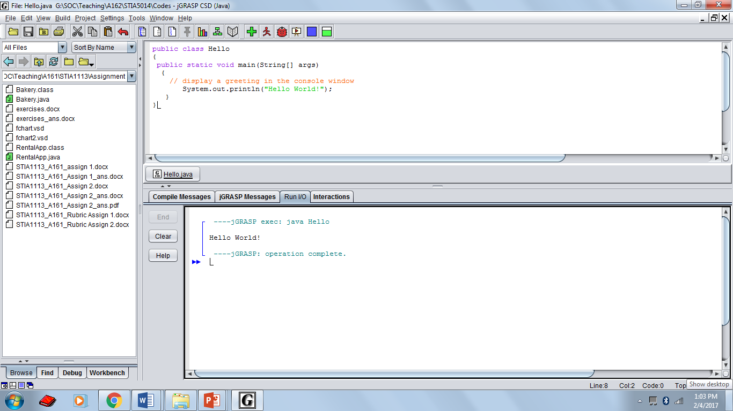
Output of the program

Slide 44
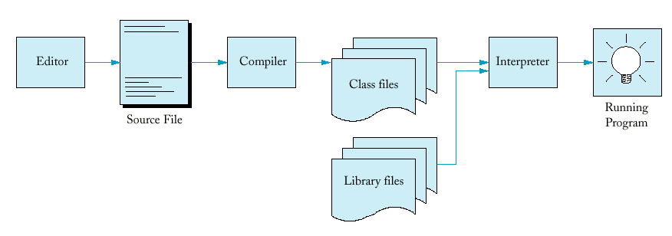
Processing a Java Program
Hello.java
Hello.class
javac
(bytecode)
JVM
Class Loader

Slide 45
Errors
It is common for programmer to make mistake in a program.
Three kinds of errors:
Syntax errors
Runtime errors
Logic errors

Slide 46
Syntax Errors
Grammatical mistakes in a program.
The grammatical rules for writing a program are very strict.
The compiler catches syntax errors and prints an error message.
Example: using a period where a program expects a semicolon
System.out.print("Hi, I am Ali"),
System.out.print("Hello);
;
"

Slide 47
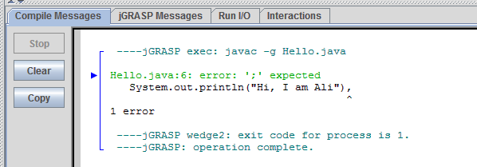
Syntax Error

Slide 48
Runtime Errors
Errors that are detected when your program is running, but not during compilation.
When the computer detects an error, it terminates the program and prints an error message.
Example: attempting to divide by 0.
total = 90/0;

Slide 49
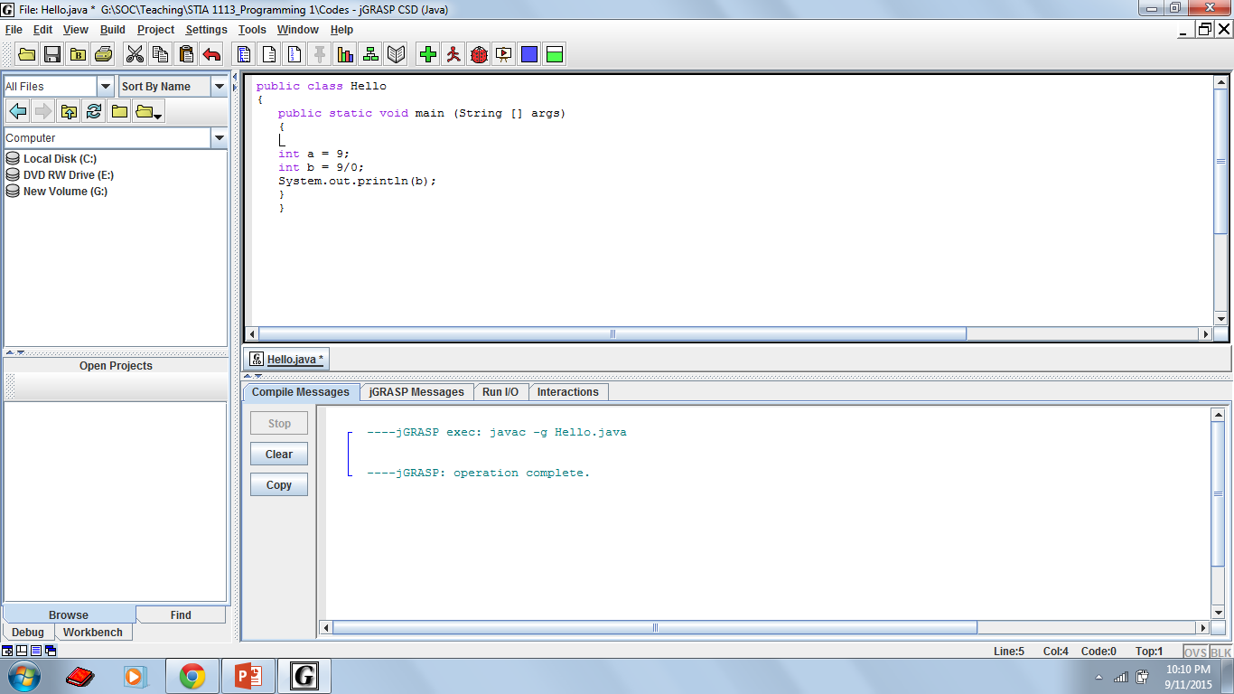
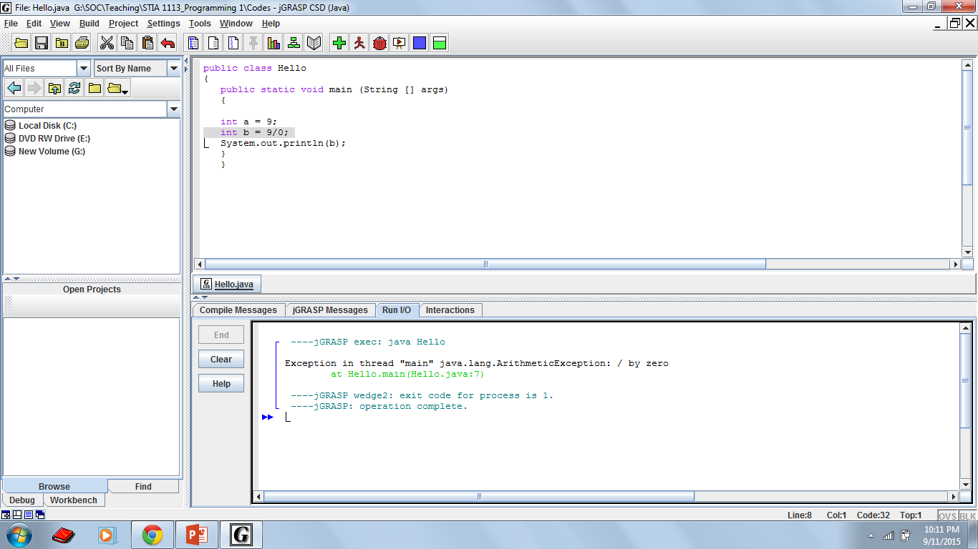
Runtime Errors
No error

Slide 50
Logic Errors
Errors that are not detected during compilation or while running but cause the program to produce incorrect results.
Example: an attempt to calculate the total of groceries that you buy, instead of summing the values, you subtract the values.

Slide 51
Logic Error

Slide 52
Creating a Java Program…
Create/modify source code
Source code
Compile source code
Syntax errors
Byte code
JVM
Run byte code
Output
Runtime errors or
incorrect results

Slide 53
EXERCISE
Write this program:
Define the class name as DisplayMessage.
Put single line comment about the class:
This class displays the students’ interest
Put multiple line comment to display message:
Display a message in the console window
The program will display this message:
I like PROGRAMMING in JAVA very much!

Slide 54

TODAY’S TAKE AWAY
Understand what is programming
Learn about the architecture of computers
Learn about level of programming languages
Learn about computing environment and your compiler
Learn how to compile and run your first Java program
Recognize 3 types of errors

